Slide 1
16.216
ECE Application Programming
Instructor: Dr. Michael Geiger
Fall 2013
Lecture 33:
Dynamically allocated data structures

Slide 2
Lecture outline
Announcements/reminders
  Program 9 due today
  Program 10 posted; due 12/11
Review
  Dynamically allocated strings, 2D arrays
Today’s class
  Dynamically allocated data structures
ECE Application Programming: Lecture 33

Slide 3
Review
1-D array
arr = (int *)malloc(n * sizeof(int));
  Can then use array notation: arr[i] = 0;
String containing n characters
str = (char *)malloc(n + 1);
2-D array
  Data type: “pointer to pointer”: int **twoDarr;
  1st dimension depends on # rows
    twoDarr = (int **)malloc(nRows * sizeof(int *));
  2nd dimension depends on # columns
    Must allocate for each row
    for (i = 0; i < nRows; i++)
    twoDarr[i] = (int *)malloc(nCols * sizeof(int));
ECE Application Programming: Lecture 33

Slide 4
Dynamic allocation and structures
Can use sizeof() to get # bytes in structure
Examples (using StudentInfo struct):
StudentInfo *p;
p = (StudentInfo *)malloc(sizeof(StudentInfo));
StudentInfo *arr;
int n;
printf("Enter array size: ");
scanf("%d", &n);
arr = (StudentInfo *)malloc(n * sizeof(StudentInfo));
ECE Application Programming: Lecture 33

Slide 5
Data structures
Data structure: way of storing and organizing data
  Arrays are one relatively inefficient example
Other structures designed to optimize:
  Organizing / sorting data
  Adding new data
  Removing unwanted data
  Searching for data
ECE Application Programming: Lecture 33

Slide 6
Pointer-based data structures
Many structures extensively use pointers
Each element within structure contains data + pointer(s) to one or more other elements
Usually functions for common operations
  Add new element
    Dynamically allocate new element
    Modify appropriate pointer(s) in other element(s) to point to new element
    Set pointer(s) in new element to point to other(s)
  Delete element
    Modify pointer(s) in other element(s) so they don’t point to element being removed
    Deallocate removed element
  Find element
    Follow pointers to move from one element to next
ECE Application Programming: Lecture 33

Slide 7

Linked list
Simple pointer-based structure: linked list
Each element (node) contains data + pointer to next element in list
Last element points to NULL
Program using list needs pointer to first node
Image source: http://en.wikipedia.org/wiki/Linked_list
ECE Application Programming: Lecture 33

Slide 8
Linked list definition
Structure to hold list of integers
typedef struct node {
int value; // Data
struct node *next; // Pointer to
// next node
} LLnode;
Note definition style has changed slightly
  Type “name” both before and after { }
  Name before (struct node) is necessary to use type inside structure definition
  Name after (LLnode) can be used in rest of program
ECE Application Programming: Lecture 33

Slide 9
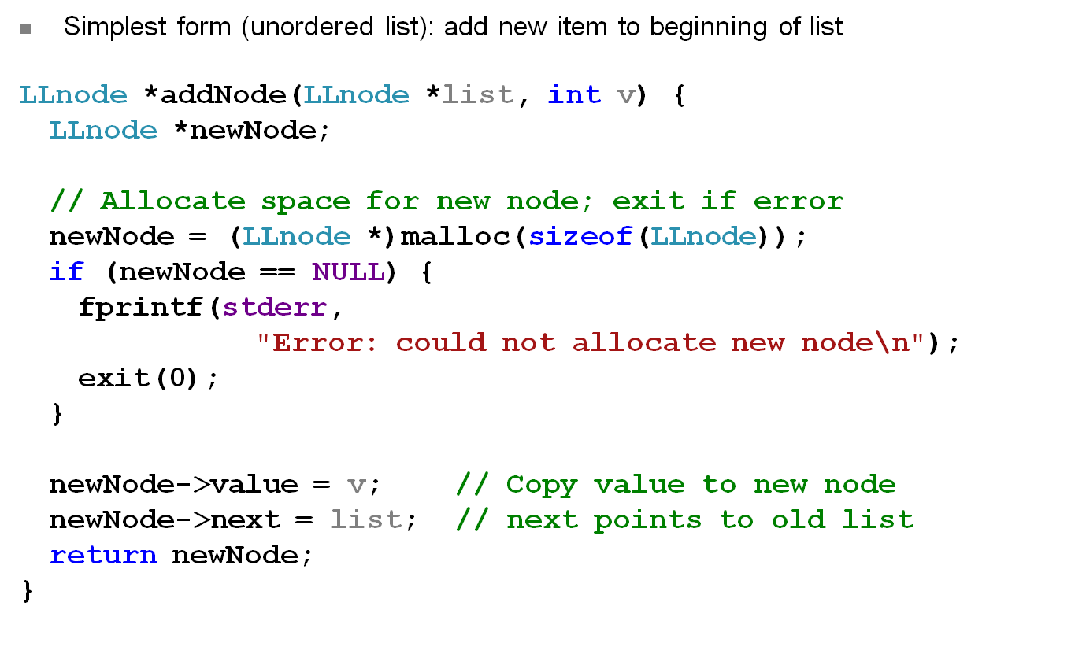
Adding to list
ECE Application Programming: Lecture 33

Slide 10
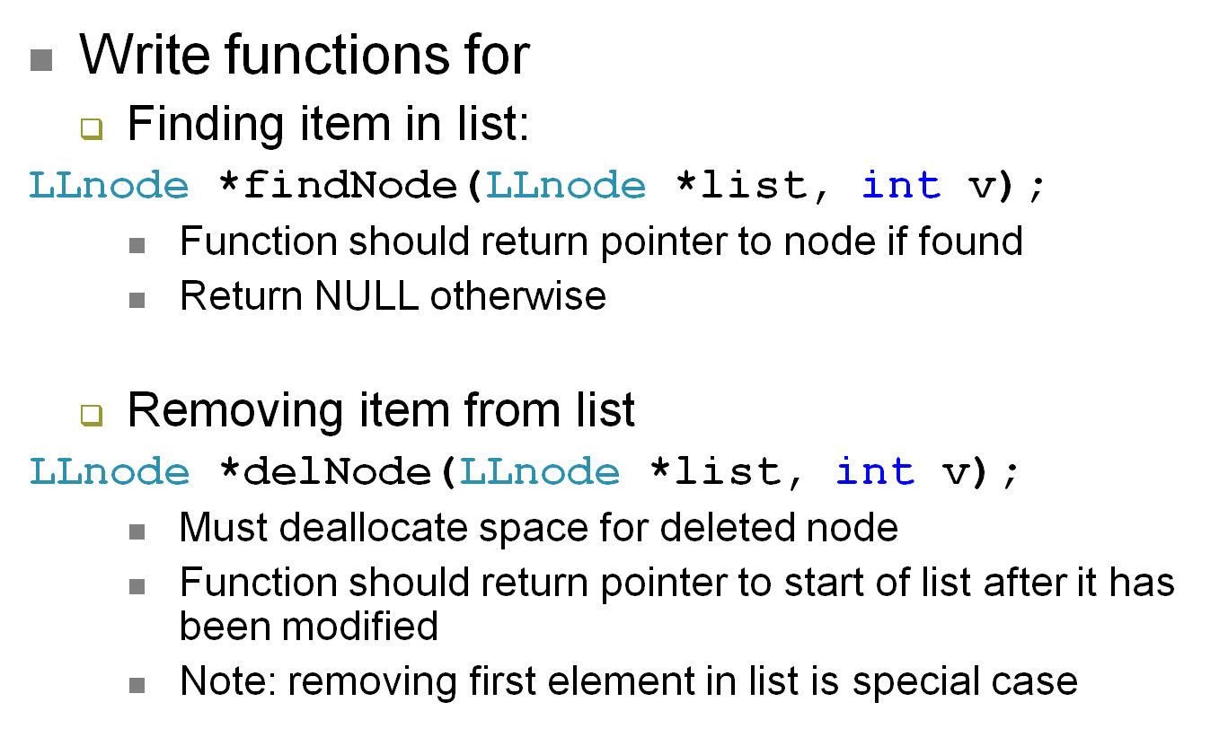
Examples
ECE Application Programming: Lecture 33

Slide 11
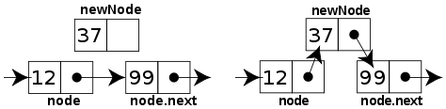
Sorted linked list
Can ensure each item is sorted as it’s added
  Slower item insertion, but faster search
Not easy with arrays: must move existing data
Keeping linked list sorted
  Find appropriate location
    Often done by going “past” appropriate spot
  Modify pointers
    Node before correct spot points to new node
    New node points to node after correct spot
    Image source: http://en.wikipedia.org/wiki/Linked_list
ECE Application Programming: Lecture 33

Slide 12
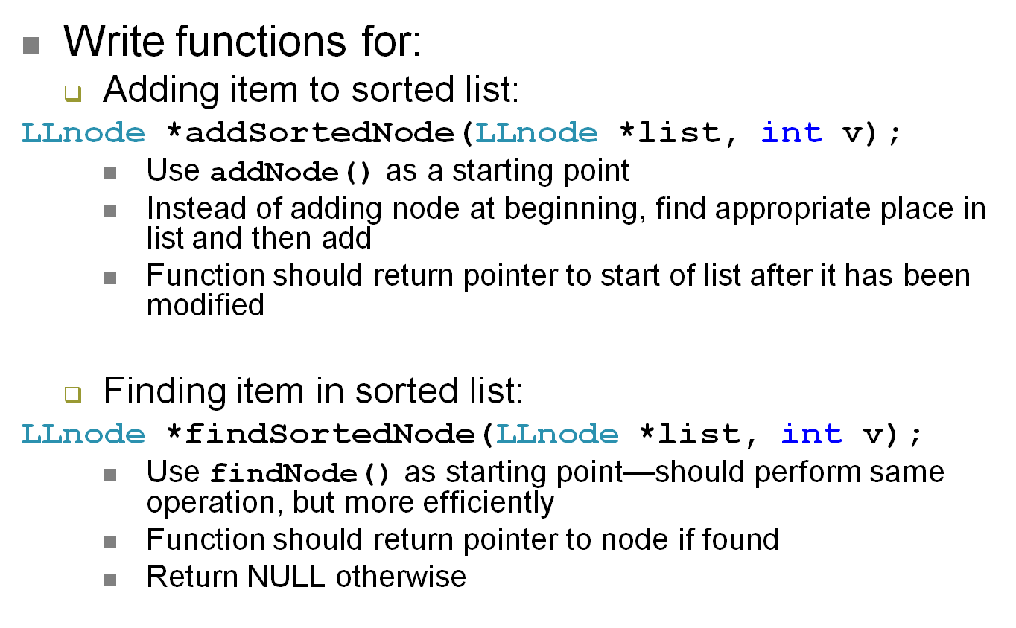
Examples
ECE Application Programming: Lecture 33

Slide 13
Next time
Continue discussing dynamically allocated data structures
Reminders:
  Program 9 due today
  Program 10 posted; due 12/11
ECE Application Programming: Lecture 33

